Slide 1

A.P.T.
wehackpeople.com

Slide 2
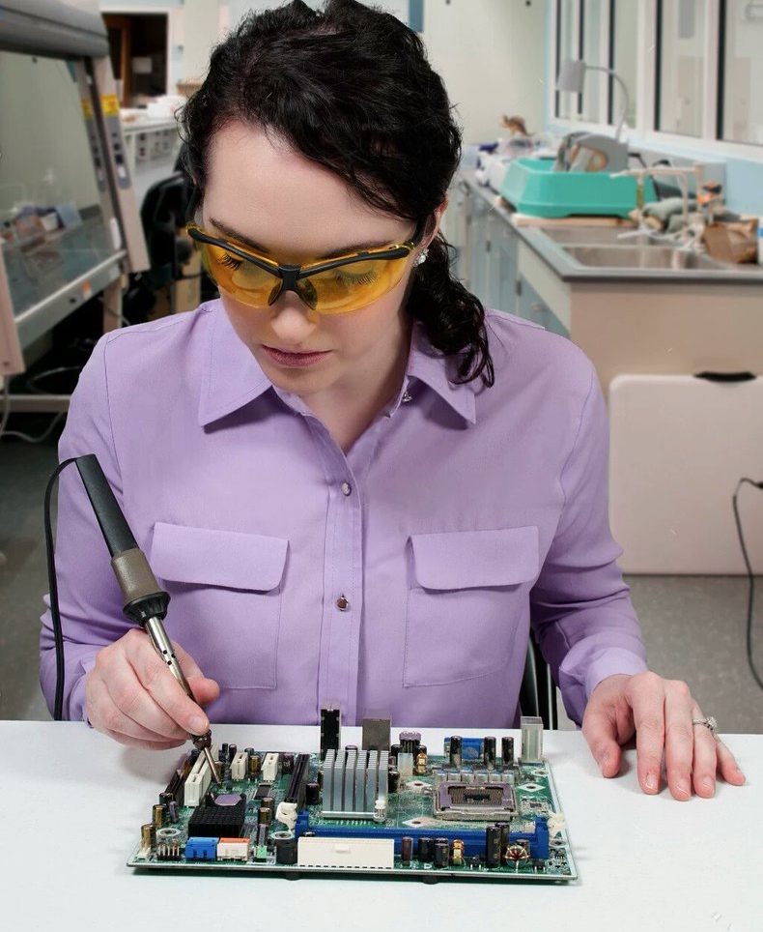
The threat of APT
What is APT?
APT is a threat that is:
Advanced
Persistent

Slide 3
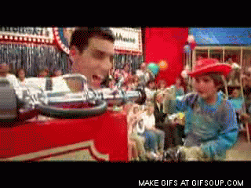
Does it really happen?
Who does APT?
Hacktivists
State-sponsored attacks
Skript Kiddies

Slide 4
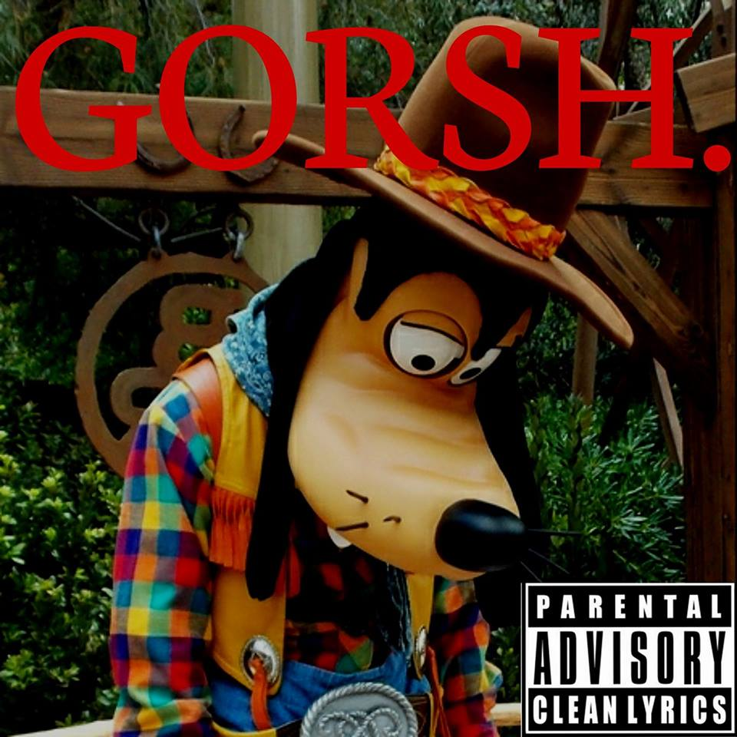
Emotional Wear
This situation can be difficult to process, emotionally.
Learn how to deal with these feelings.
Remember, you’re not alone!

Slide 5
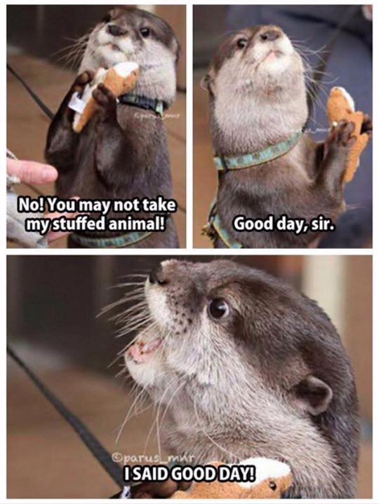
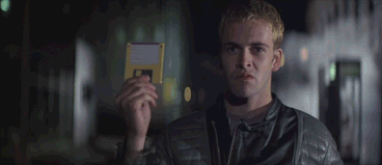
Stopping it?
How do you take away their power?
Step 1
Step 2
Step 3

Slide 6
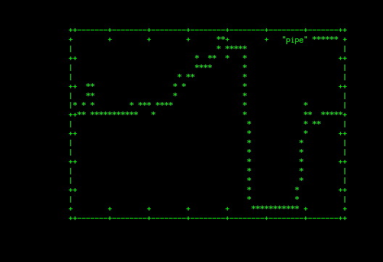
Detecting the APT
Analyze things
“Threatening the threats”

Slide 7

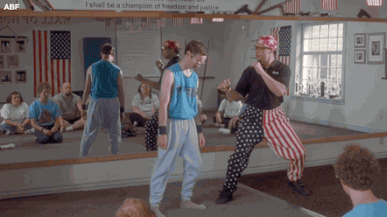
Prevention?
How in the world do you stop it?
Is it possible to keep up with everything?
YES!!
Kick them to the cyber-curb!

Slide 8
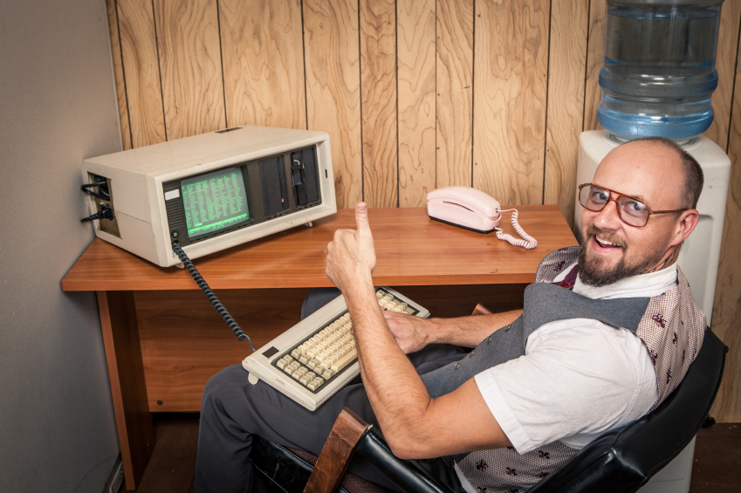
Great Job!
You found them & followed the steps!
Now your totes cyber-secure from the APT!

Slide 9
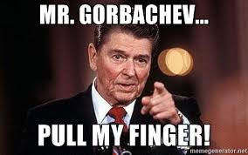
Thank you!
Questions?

